Slide 1
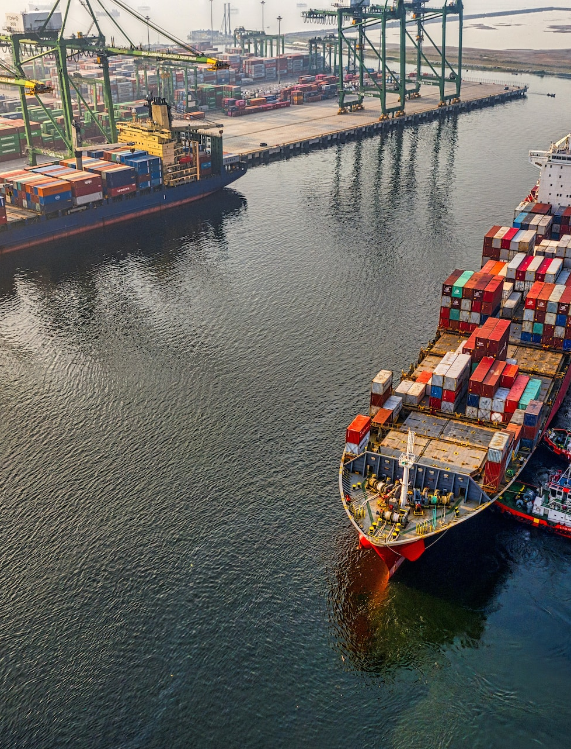
Data-Centric Engineering

Slide 2
What is ‘data-centric engineering’?
Data has always been used in engineering
Access to:
Data at multiple scales in time and space Measurement and instrumentation via whole sensor networks Compute infrastructure at global scale New theory, technologies, markets, business models, education, skills, AI enabling
‘Data-centric engineering’ encourages industries to recognise what can be achieved by utilising data at scale and adopting data-centric practices as standard

Slide 3

Data-Centric Engineering at the Turing
LRF ‘Foresight review of big data’ (2015)
DCE programme launched in 2015 in partnership with the Lloyd’s Register Foundation initial £10M support
Aim: formalise data-centric engineering as a discipline in its own right
Notes:
The background to setting up the programme – LRF published its Foresight review of big data which considered how safety can be improved by using big data to fundamentally change the design, manufacturing, maintenance and decommissioning processes for complex infrastructures and machinery.
LRF partnered with The Alan Turing Institute to found the Data-Centric Engineering programme and formalise the use of data techniques and tools within engineering.

Slide 4
DCE 1.0 – the vision
Bringing together world-leading academic institutions and major industrial partners from across the engineering sector, to address new challenges in data-centric engineering.

Slide 5

DCE 1.0 aims
Establishing and growing a DCE community
Leading the way
A global conversation
Engaging the public
Training and development
Notes:
The Turing partnered with LRF to found a programme that would work to:
Grow the DCE community – both within the Turing university network and beyond. Creating the first generation of DCE leaders by building a group of researchers and industry partners with a shared vision for the future of engineering. Through collaborative and cross-disciplinary research projects, both foundational and applied, publishing papers, presenting at conferences, hosting workshops and seminars.
Lead the way – not only in research but in policy and application. The DCE programme works on national and international levels, contributes to advisory committees, and policy reports. It is leading the way in the adoption of of data-centric and AI techniques within various engineering fields through roadmapping for example in the Marine and Maritime industries.
An international conversation – the programme is driving forward DCE globally, through MoUs with a number of international institutions. An international workshop on DCE was hosted at MIT to develop a unified vision for how data-centric methods can empower engineering research, education and professional practice. The DCE Summit in 2021 will further this global conversation.
Engaging the public – the Turing works actively to communicate the value of its research to the general public. Through media pieces, blogs, podcasts, impact stories, public lectures, the programme aims to improve public understanding of the importance of data science and AI across engineering.
Training and development – the programme aims to support training and continued professional development not only within academia but across industry as well. Sharing skills that can be put directly into application. For example through the Effective Quadratures workshops.

Slide 6


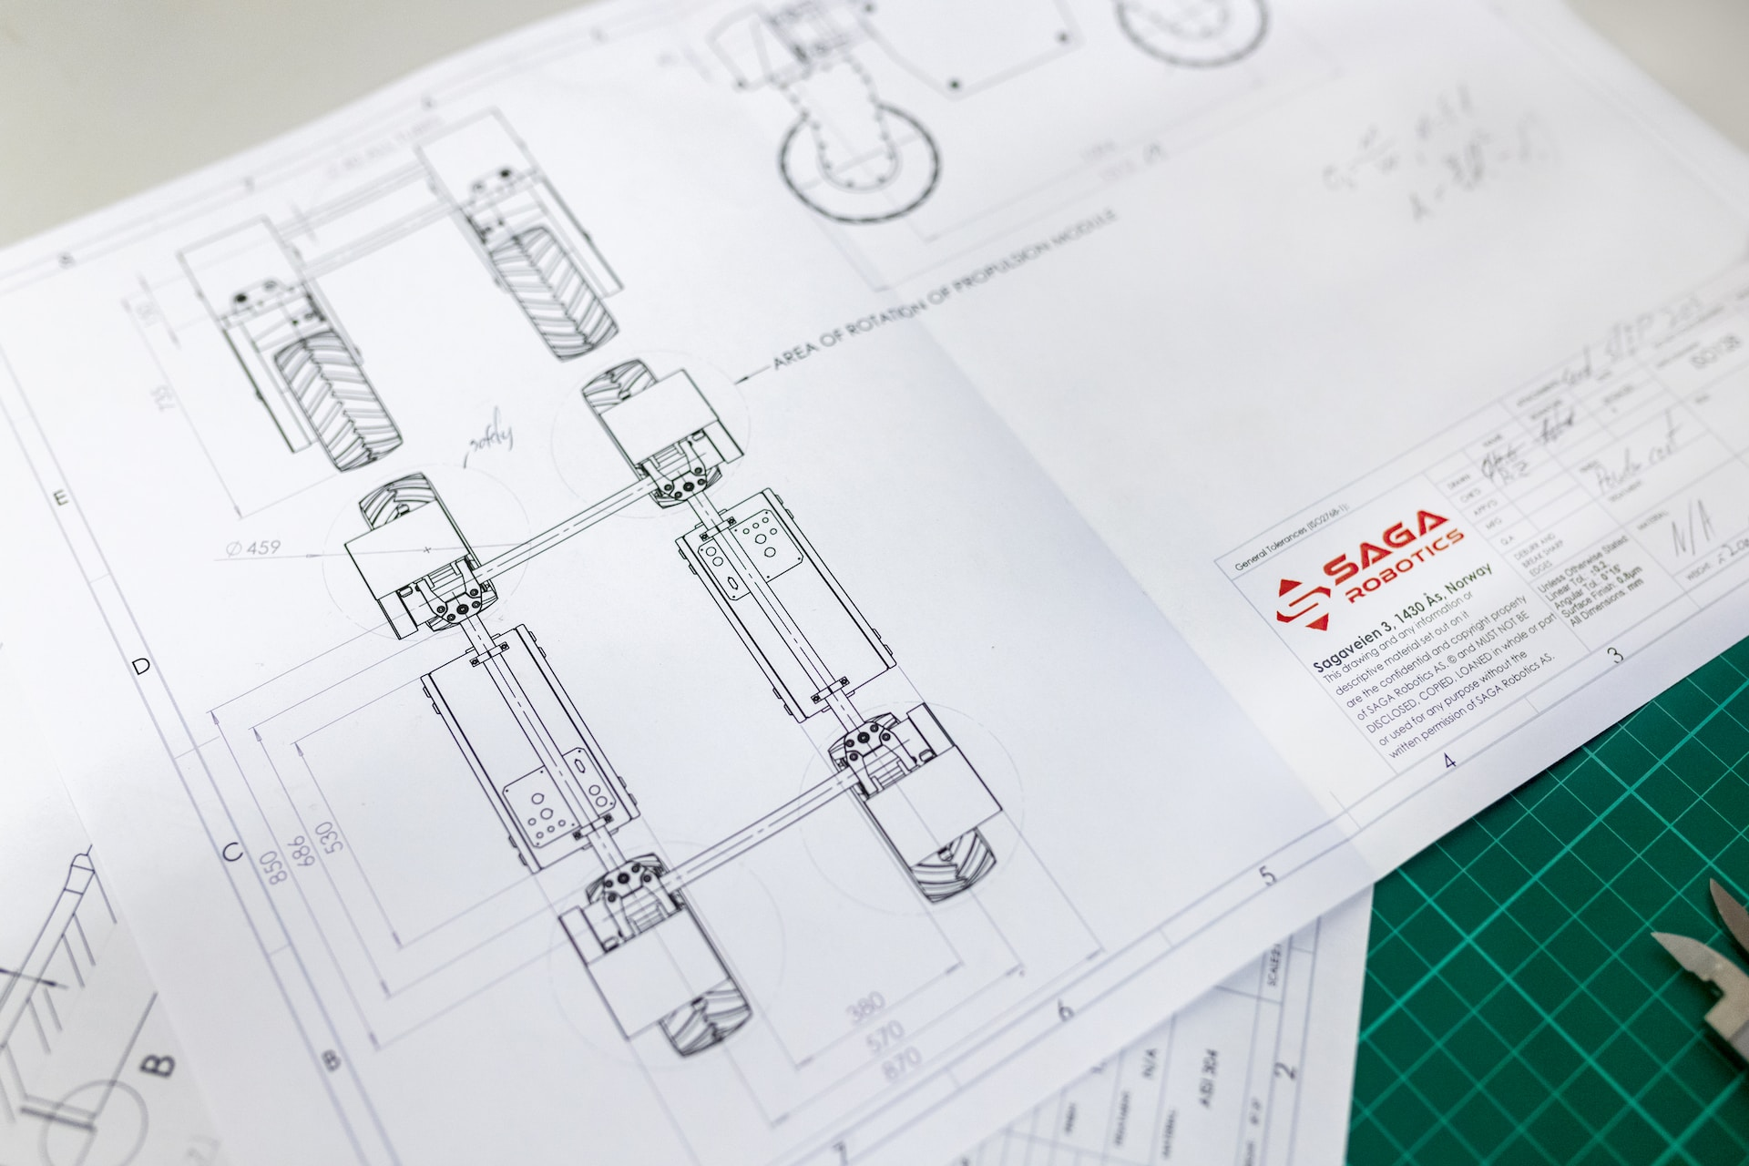
Grand Challenge 1:
Resilient and robust infrastructure
Grand Challenge 2:
Monitoring complex engineering systems
Grand Challenge 3:
Data-driven design under uncertainty

Slide 7






DCE 1.0 – some achievements
DCE Journal founded and first papers published
8 UK and international memoranda of understanding: USA, Canada, Australia, Finland, Norway and UK
Advising UKRI for digital twin investments
Demonstrating the first urban digital twin for London’s air pollution
Developing data-driven methods for infrastructure, sensing and maintenance – Staffordshire Bridge
Large grants: DARE, TIDE, PREMIERE, DataSig, CoSines
Total funding into data-centric engineering community: £83.6m (8x RoI on LRF funding)
Faculty positions, CDTs, Masters programmes DCE
Renewed funding with LRF establishing a long-term partnership based on the success of phase 1
Notes:
Some achievements of the programme to date.
Some of the organisations and companies the programme works with

Slide 8

DCE 1.0 - some numbers
300+ researchers engaged on programme projects
68 postdocs and 45 PhD students
370+ papers published/ accepted
62 software repositories developed/under development
300+ talks at UK/world events
90+ policy engagements
274 media articles, features, blogs, podcasts
Use of term ‘data-centric engineering’ in non-Turing contexts (Google)
13 | 102 | 211 | 539 | 744
2018 | 2019 | 2020 | 2021 | 2022
Notes:
Some numbers relating to the programme

Slide 9


DCE Global
Finnish
Centre for AI
MoU signed
ANRC
University of Strathclyde
EPSRC PP
AMRC,
University of Sheffield
MoU signed
CANSSI
MoU signed
MX3D,
University of Twente
MIT
Autodesk
Oden Institute, University of Texas
MoU signed
National University of Singapore,
A*STAR
University
of Sydney
MoU signed
University of Western Australia
Notes:
DCE programme and projects international working relationships – either where we have had project activity or have MoUs in place.
Memoranda of Understanding signed with Oden Institute, University of Sydney, Finnish Centre for AI and Advanced Manufacturing Research Centre at Sheffield.
To be updated further to international visits!

Slide 10
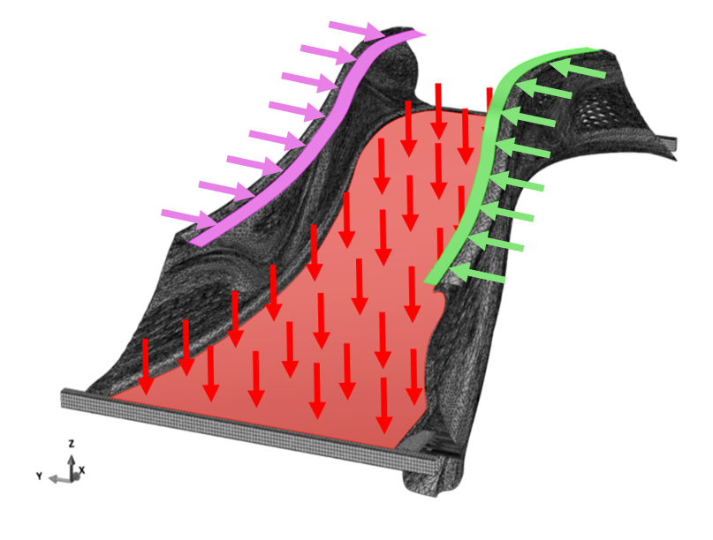
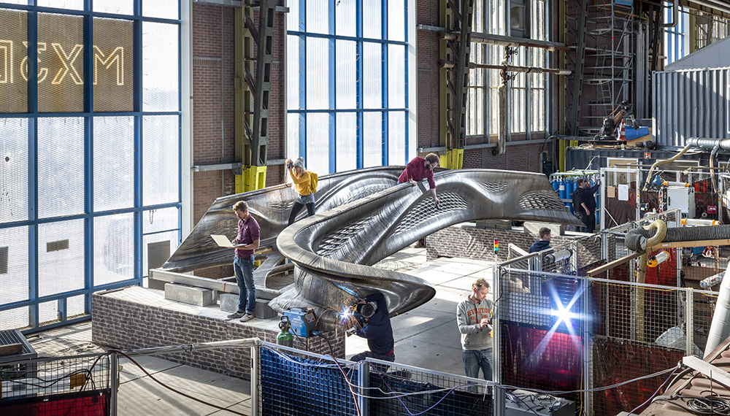
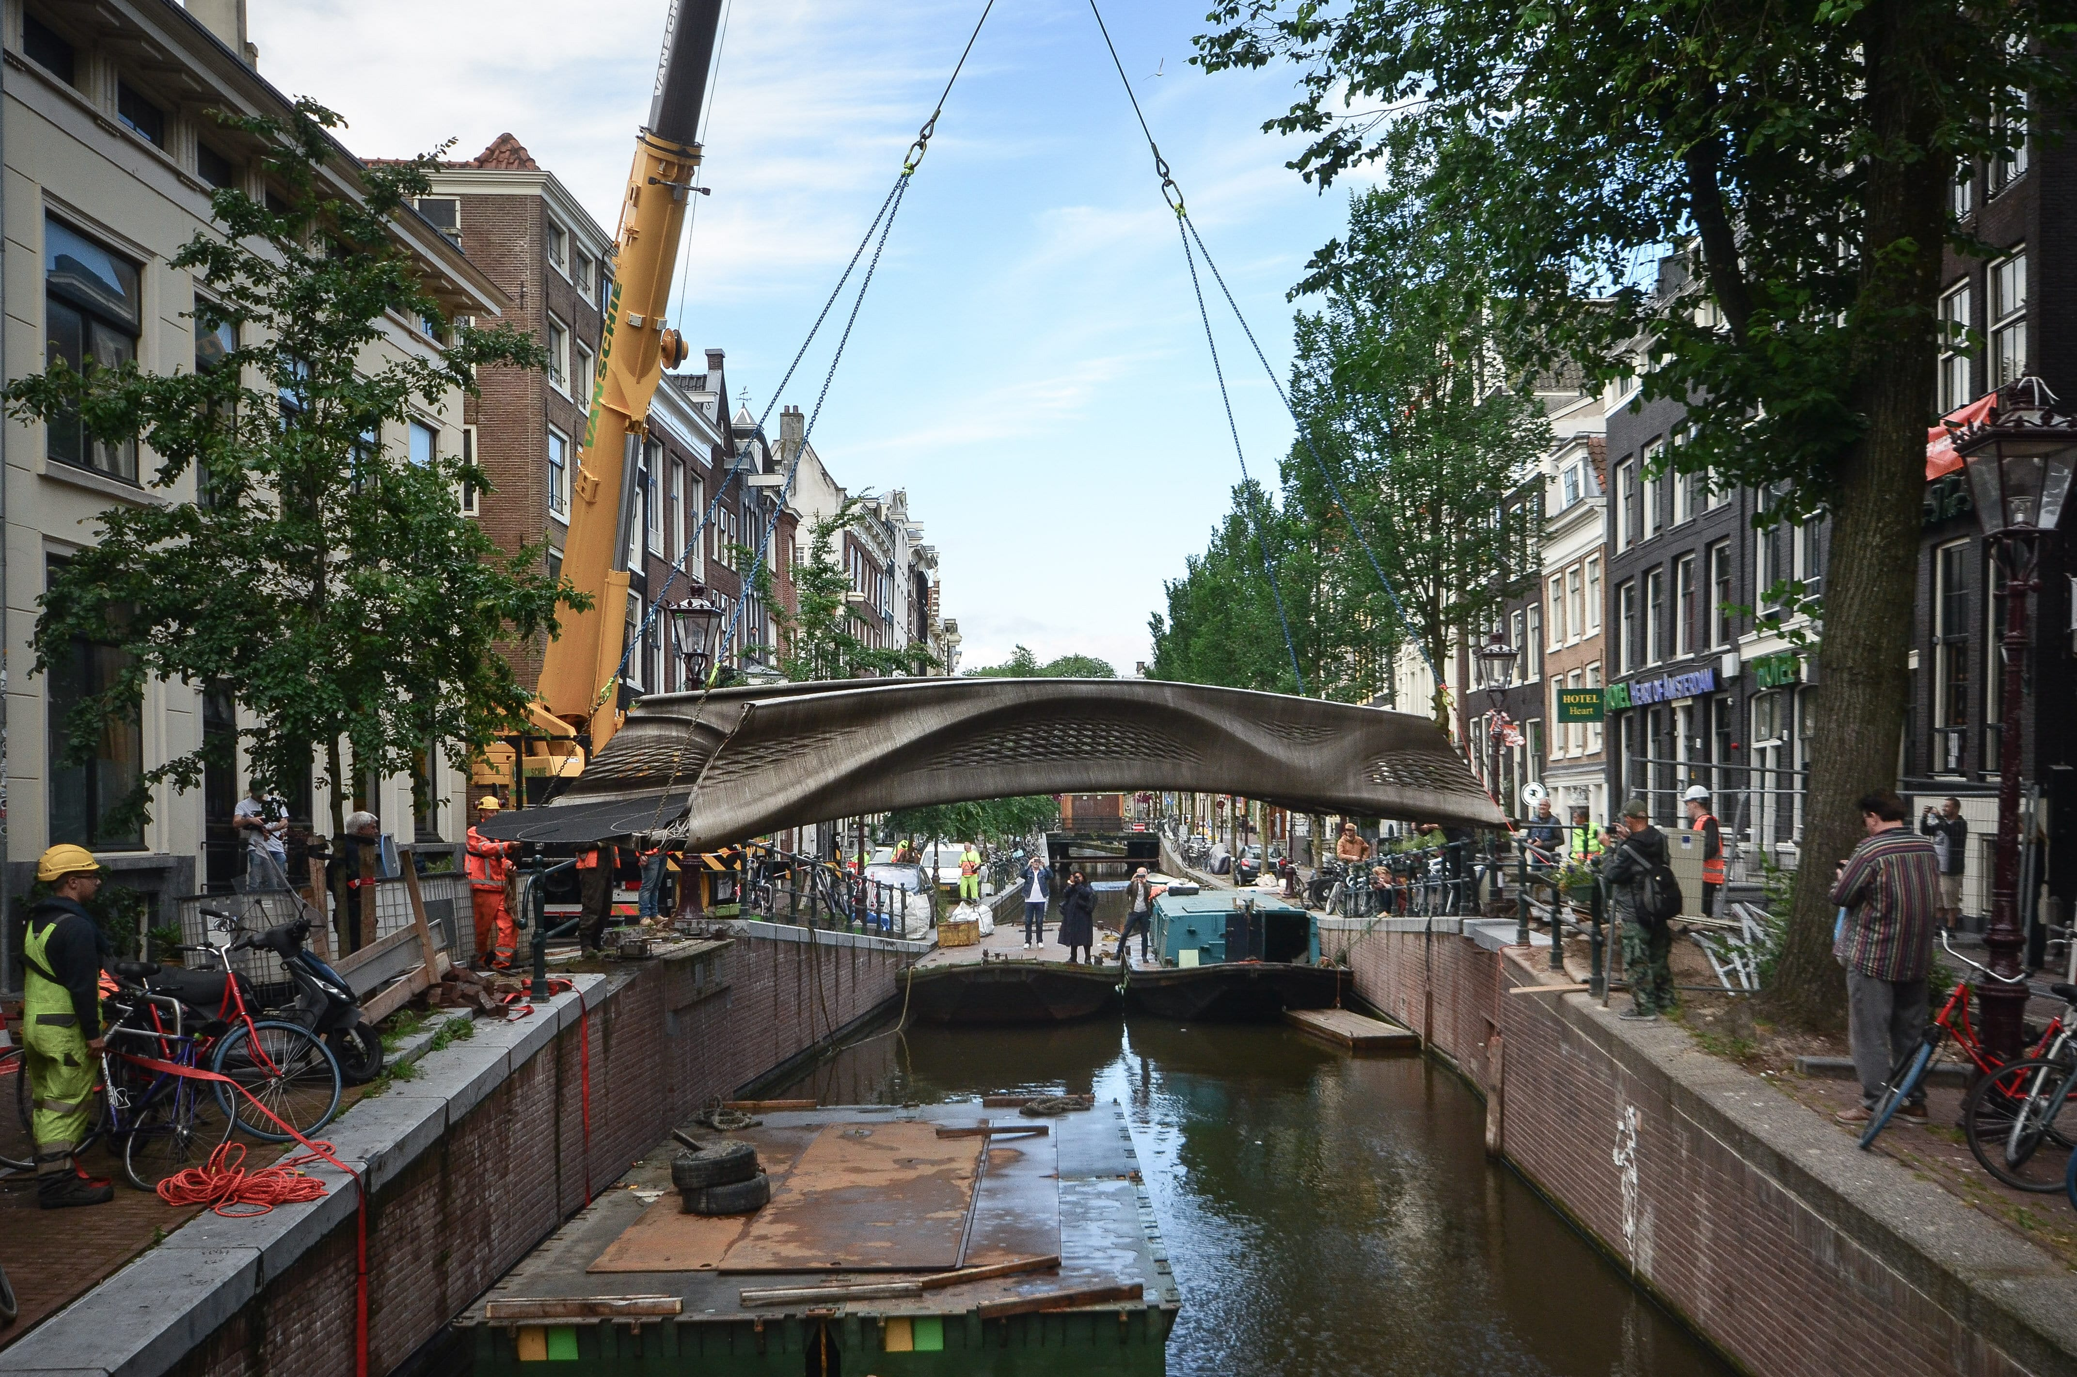
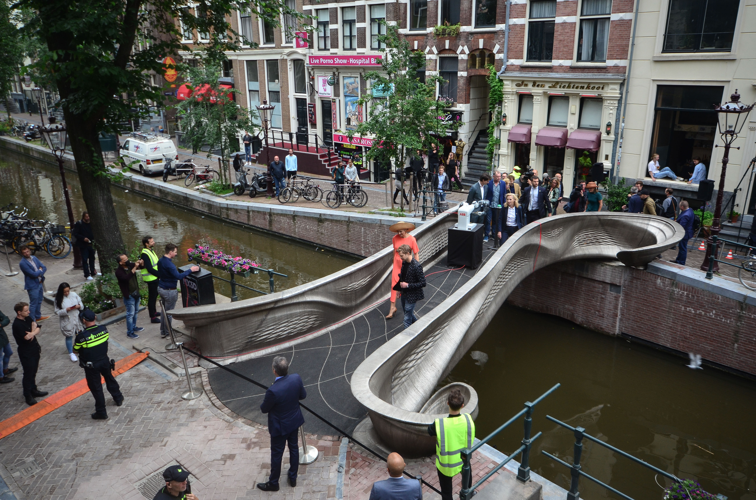
3D-printed
bridge

Slide 11
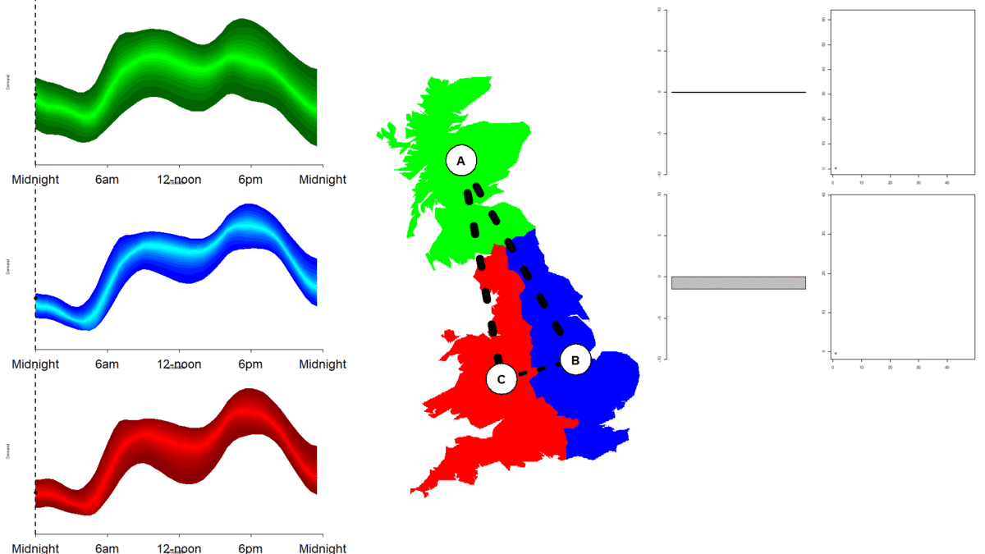
AI for control problems: rangl
Notes:
John Moriarty’s project on AI for control problems.
Complex control problems arise in the operation of critical infrastructure, including electricity, gas, water and transportation. This project is developing ‘rangl’, an AI competition environment for practitioners (both novice and experienced) to apply classical and machine learning techniques and expert knowledge to UK-centric problems. The project will work with industrial challenge holders to develop insights into the leading classes of solution.

Slide 12
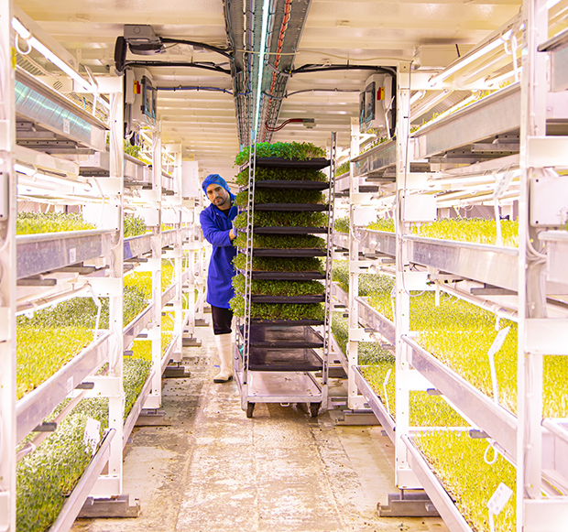
CROP – world’s first digital twin of an underground farm
Reduced time to grow some crops by 50%, all crops by an average 7%
Increased yields by 24%
Crops grown using less space and water, no pesticides, 100% renewable energy
“Having Cambridge and the Turing pushing forward on the data side really sold us on the benefits of using information to solve the sustainability challenges we faced.” Richard Ballard, co-founder of Growing Underground

Slide 13
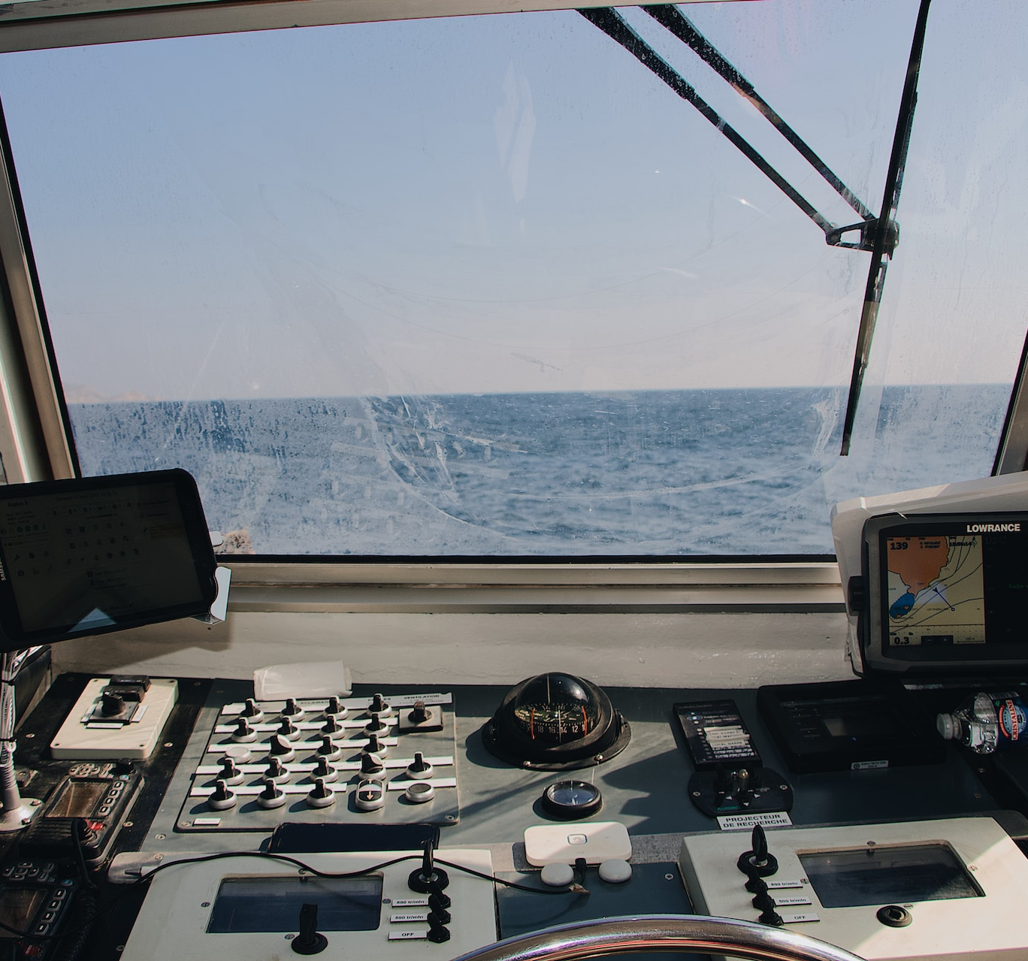
T-VOS – voyage optimisation software
First AI based multi-objective voyage optimisation software for the shipping industry
Capable of simultaneously optimizing for time, fuels, TCE and emissions
5% increase in fuel savings and reduction in emissions
7% improvement in time savings
8% improvements in delivering Time Charter Equivalent

Slide 14
DCE 2.0 – the vision To lead in the development of new approaches for Data-Centric Engineering, reducing emissions and improving safety through the delivery of new tools and practices, training and policy changes.

Slide 15




DCE 2.0 pillars
Pillar 1: Translation and pull through to adoption
Research Application Manager
Tools/applications uptake plan
DCE Research Software Engineer
Pillar 2: Standards and regulation
AI Standards Hub
AI Policy Fellow
CETAS project
Pillar 3: Skills, training and knowledge exchange
Landscape mapping
Stakeholder workshop
Skills roadmap
Pillar 4: Community building
Senior Research Community Manager
Community meetings plan and modes of working
EDI plan
Notes:
The main pillars and some initial activity under these pillars.

Slide 16

Translation and pull-through to adoption
Support the LRF SafetyTech Accelerator by providing support from researchers and connecting it to the Turing’s talent programmes.
Deploying research applications developed through DCE, to ensure research outputs can support their wider adoption, implementation and real-world impact.
Notes:
Enabling leading data science and AI experts to advise emerging businesses in SafetyTech, building on LRF “Accelerating Digital Innovation for Safety”, thus matching research excellence with the best business ideas.
Ensure that DCE open-source software is available for organisations to access to ensure the real-world application of DCE research and innovation.
Fund an annual DCE focussed Data study challenge to help bring Data science innovation into engineering businesses.

Slide 17
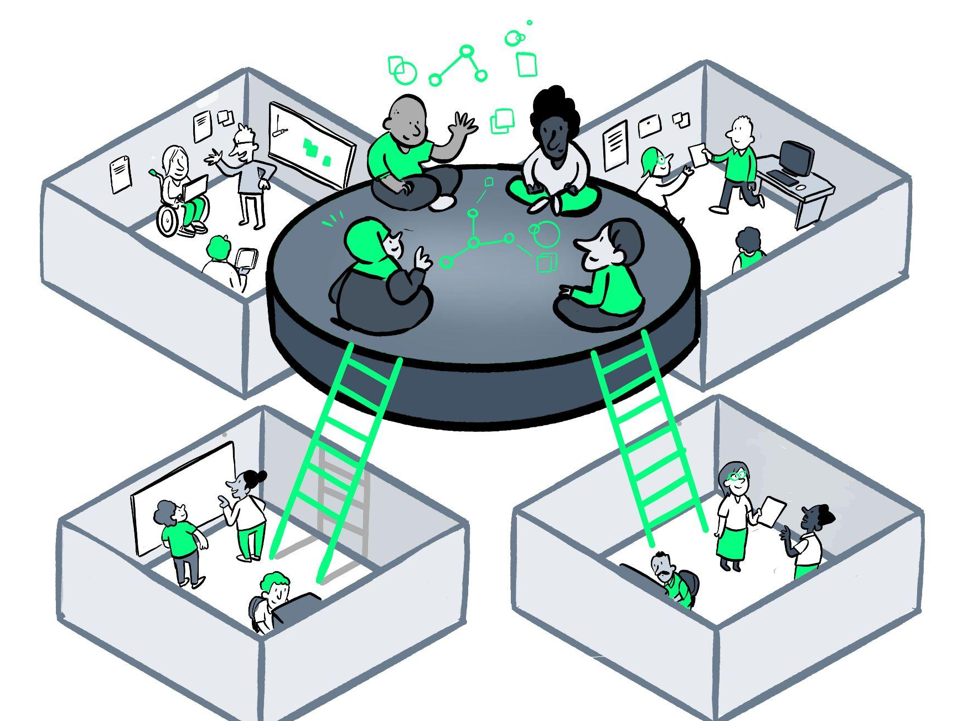





Research Community
Manager
Research
Research Community Managers empower diverse stakeholders to co-create, maintain and sustain research processes and outputs that they can equitably benefit from.
Notes:
Maps stakeholders across industry and academia
Establish a long-term roadmap of community engagement activity to help solidify and grow the community
Understand the skills needs of the community to enable upskilling
Facilitate making connections to enable new partnerships and boost the adoption of DCE
Through open, inclusive and reproducible practices, RCMs build a shared understanding of research goals, roadmap and processes.
They combine a range of socio-technical skills including scientific communications, stakeholder engagement and domain expertise.
They facilitate, amplify and champion collaborative, community-based research processes and outcomes.

Slide 18
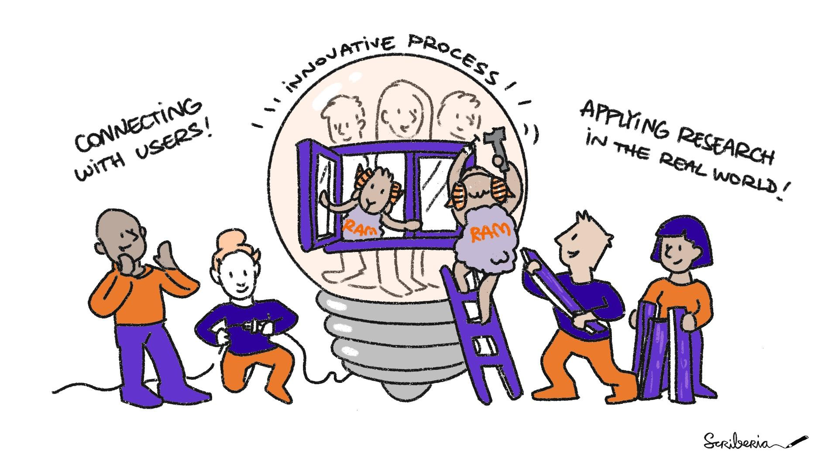
Research Application
Manager
Research
A Research Application Manager engages external stakeholders to adapt research outputs for real-world use.
Notes:
Facilitate a two-way conversation between users and researchers to share perspectives
Identify key users and target audiences
Identify sustainability and funding solutions with the research team
Approaching the output as a research “product” and bringing an appropriate level of “market intelligence” to the academic team
“Packaging” or “re-packaging” the tool to improve usability/accessibility to different audiences
RAMs make research outputs to be more usable and support their adoption by people outside of academia.
Working with research teams, we embed user needs and real-world impact potential in the design of research outputs.

Slide 19
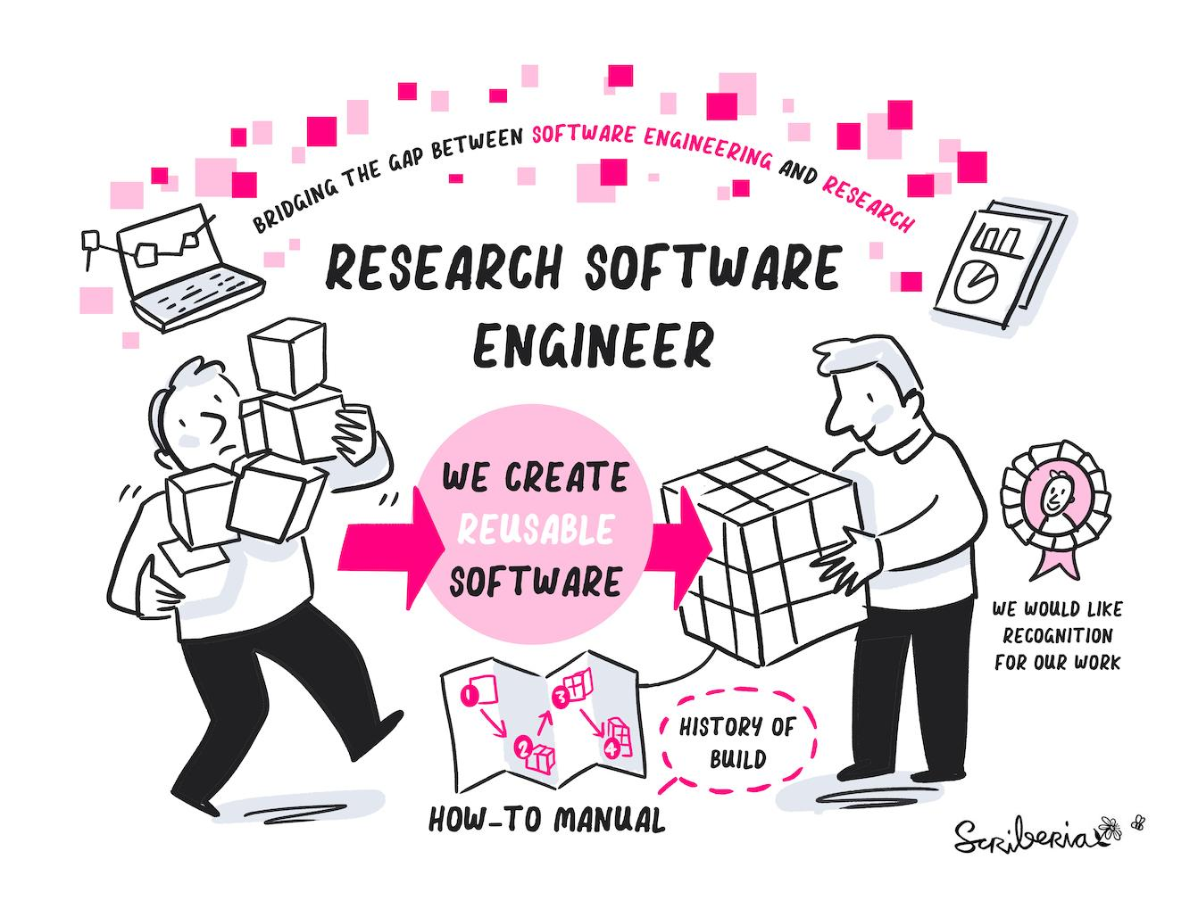
Research Data and
Engineering
Research
Research Engineering is a professional field that include Research Data Scientists and Research Software Engineers. They are expert collaborators who bring their technical knowledge and data skills to research projects.
Notes:
Research Data Scientist:
Generalists with broad skills working with data and specialist researchers across domains.
RDS creates open and reusable tools to ask questions and draw insights from data.
As expert collaborators, apply reproducible research best practices to research directly through collaboration.
Research Software Engineer:
RSEs promote software-development best practices in research software through practices such as version control, testing, documentation and reusability.
Apply and teach broad set of technical skills and expertise by being embedded on research projects.

Slide 20

Standards and Regulation
Partner with the AI Standards Hub to shape AI standards development in safety-critical domains.
Collaborate with regulators to boost understanding of data science and AI, both in terms of regulating AI and AI use for regulation in safety-critical settings.
Notes:
commission and deliver a roadmap leading, in time, to the development of standards
Boost the understanding of AI/DS in the standards community to help ensure standards are fit for purpose – AI to regulate and regulation of AI across sectors

Slide 21
AI Standards Hub
MISSION:
Advancing responsible AI by unlocking the potential of standards as governance tools innovation enablers
Empowering stakeholders to become actively involved in the international AI standardisation landscape
➤ Participation in the development of standards
➤ Informed use of published standards
Bringing together strengths and networks of three key UK institutions:
National Institute for Data Science and AI (the Turing)
National Standards Body (BSI)
National Metrology Institute (NPL)
Support from and close collaboration with the UK Government (DCMS, Office for Artificial Intelligence)
Notes:
BSI – British Standards Institute
NPL – National Physics Laboratory
DCME – Department for Digital, Culture, Media and Sport
Will ask AISH for a branded slide!

Slide 22

Skills, Training and KE
Two-way skills exchange – embedding entrepreneurial and innovation acumen into the Turing, and AI researchers within a range of organisations focused on safety.
Influencing the skills agenda and encouraging the adoption of data science educational standards by professional bodies.
Leveraging the Turing’s skills provision by supporting DCE-focused Data Study Groups, Train-the-trainer programmes and internships.
Notes:
Turing to commission the delivery of new and ambitious open-source online data science and AI training modules, DCE-inspired, to support CPD for engineers working in safety-critical domains, and to instil fresh engineering mindset in buddying data scientists and AI specialists
Embed entrepreneurial acumen in the Turing to identify ideas ready to be spun out, working with PhD students to instil them with entrepreneurial DCE skills
Researchers at different stages of their careers with a range of organisations focused on safety in the LRF innovation ecosystem.

Slide 23

Build and sustain a community
Build one the critical mass of research activities and people supported during the first phase of the partnership.
Build on the Turing experience working with other organisations across DCE in safety-critical sectors and reaching into priority domains such as Marine and Maritime.
Develop and consolidate international partnerships with Oden Institute, Data61, University of Western Australia, Aalto and through partnering with the RAEng.
Notes:
Accelerating the development of new partnerships across DCE, building on our experience of working with safety-critical organisations such as NATS and Rolls-Royce. New partnerships bring new routes to impact, access to data assets (often proprietary), with potential for innovation spillovers. New partnerships with JLR (predictive maintenance). Marine and maritime.
Continue to build relationships with the likes of Oden/Data61, UWA, Aalto and other organisations in regions that help meet The Turing and LRF’s strategies
Utilise a community manager to help build a community across academic and industry.

Slide 24




Priority themes
Ocean safety (including decarbonisation, trade security, cybersecurity, trustworthy AI)
Digital manufacturing (including AI safety)
Critical infrastructure
Humanities and DCE
Notes:
These evolve naturally from the 1st 5 years of our Strategic Partnership.

Slide 25

Ocean Safety
Developed in 2020 through a workshop to launch the Turing Marine and Maritime Group
AI/ML tools needed to deal with issues such as decarbonisation, security, increasing quantities of trade and safety when scaling up shipbuilding
M&M requires distinct tools due to a range of challenges unique to the sector inc. equipment lifespan, lack of data, and an unpredictable operating environment
Notes:
Accelerating the development of new partnerships across DCE, building on our experience of working with safety-critical organisations such as NATS and Rolls-Royce. New partnerships bring new routes to impact, access to data assets (often proprietary), with potential for innovation spillovers. New partnerships with JLR (predictive maintenance). Marine and maritime.
Continue to build relationships with the likes of Oden/Data61, UWA, Aalto and other organisations in regions that help meet The Turing and LRF’s strategies
Utilise a community manager to help build a community across academic and industry.

Slide 26

Critical infrastructure
In partnership with the ANRC (University of Strathclyde)
Options for implementing Human-In-The Loop (HITL) AI solutions, so as to support human decision making
Collaboration has already developed capabilities in predictive analytics for nuclear assets
Use-case for Digital Twins across a number of areas, from construction through to decommissioning

Slide 27
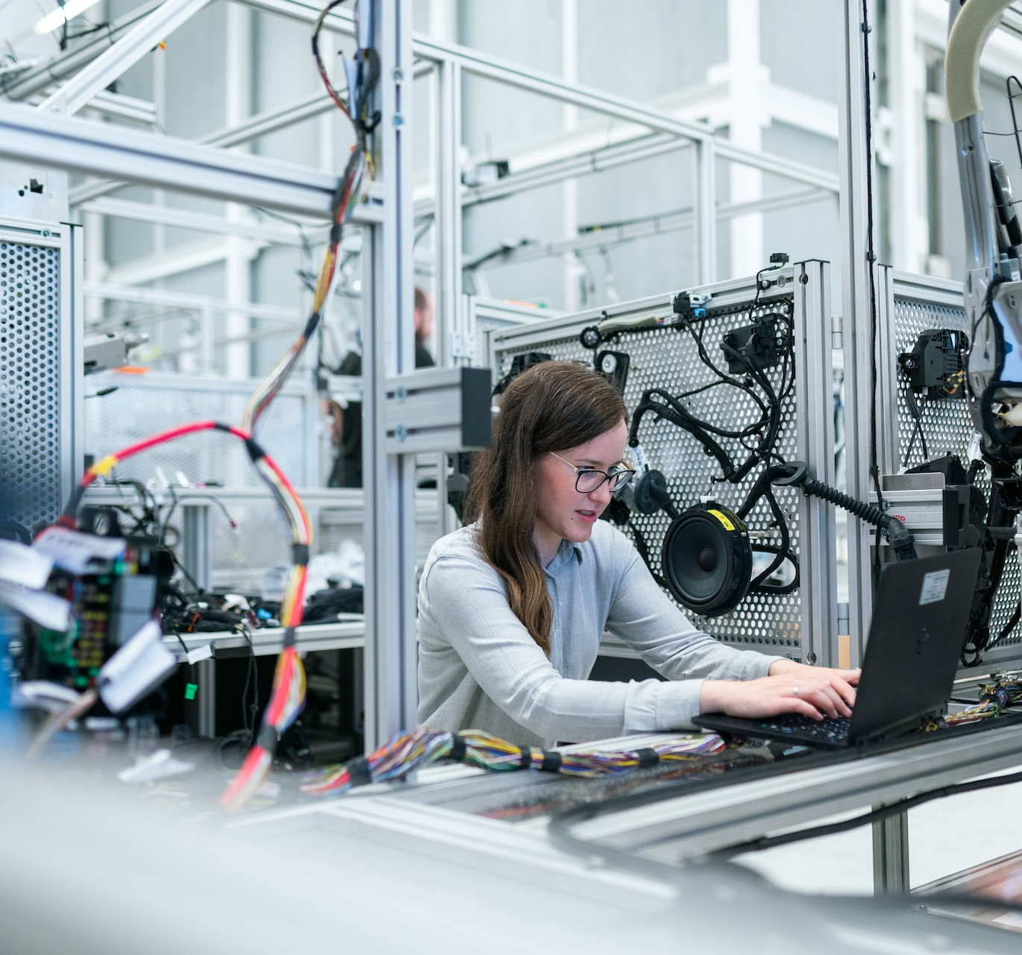
Digital manufacturing
In partnership with the AMRC (University of Sheffield)
High number of injuries that could potentially be avoided using AI/ML
Looking towards AI to assist in the recognition, avoidance and prediction of potential health and safety risks
Notes:
Accelerating the development of new partnerships across DCE, building on our experience of working with safety-critical organisations such as NATS and Rolls-Royce. New partnerships bring new routes to impact, access to data assets (often proprietary), with potential for innovation spillovers. New partnerships with JLR (predictive maintenance). Marine and maritime.
Continue to build relationships with the likes of Oden/Data61, UWA, Aalto and other organisations in regions that help meet The Turing and LRF’s strategies
Utilise a community manager to help build a community across academic and industry.

Slide 28
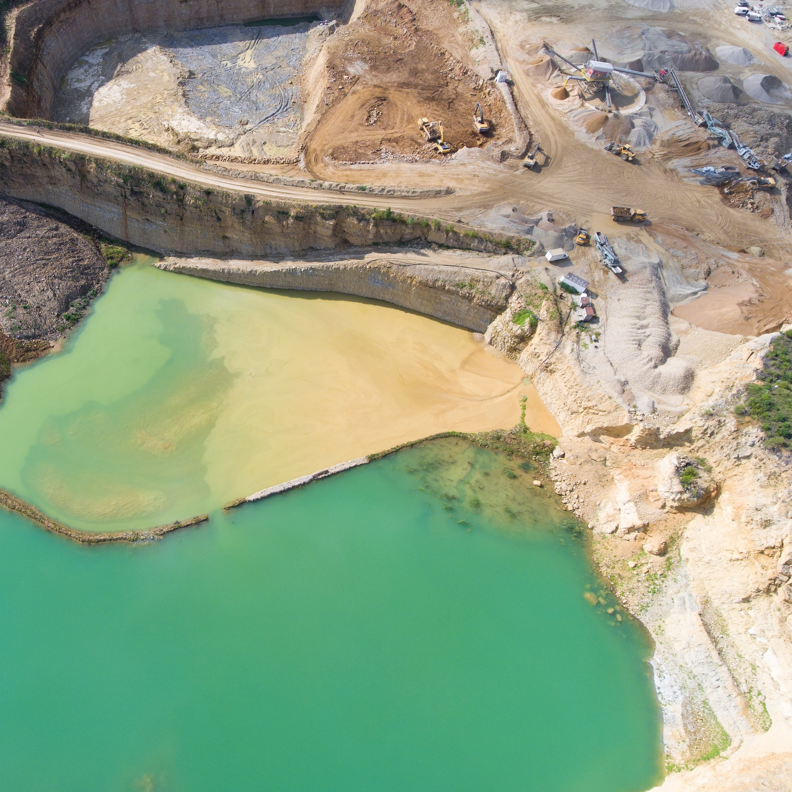
Humanities and DCE
DCE community understanding the values and methods of arts, humanities and social sciences research
How does DCE affect the world in the broader context – social, economic, political, ethical?
Developing radical interdisciplinary methods for sharing and producing data between communities

Slide 29

Splunk Centre for Foundational DCE
‘Develop an AI Data Engineer’
Provide foundational research to future proof DCE
Focus on reinforcement learning/multi-agent model
Initial intake 3x PDRAs for 3- year contracts

Slide 30


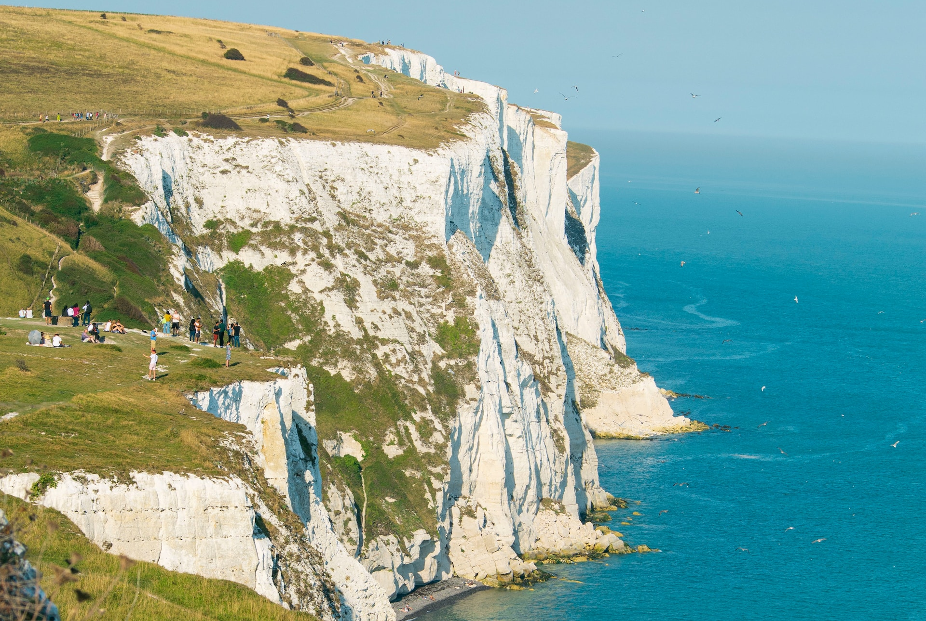
Projects
CETaS
Center for Emerging Technology and Security
Cybersecurity attacks on renewable energy devices
Enhancing the resilience of coastal bases, defence and commercial maritime industry to climate change
ADViCE
DESNZ
AI innovation for decarbonisation’s virtual centre of excellence
£500k (£150k to DCE)
Aim: fostering collaboration between stakeholders in AI/tech and energy/climate sectors
Short straits digital twin
DfT
£500k (£180k to DCE)
Aim: Inform DfT of potential traffic and logistics issues Port of Dover/English Channel

Slide 31






Potential future themes
Aerospace
Space
Renewable energy
Automotive
Bioengineering
Rail
Notes:
These evolve naturally from the 1st 5 years of our Strategic Partnership – what we need is some help prioritising these from an impact delivery perspective.
Which themes resonate better from a LRF perspective? Which are more exploratory and require more landscape analysis, ground work in order to establish whether they should be priorities or not?

Slide 32
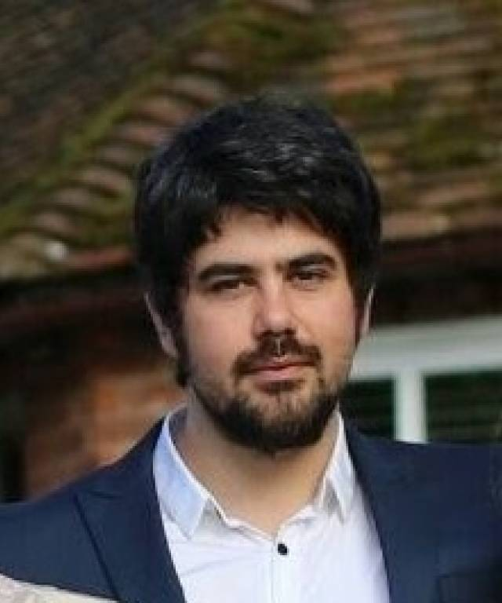
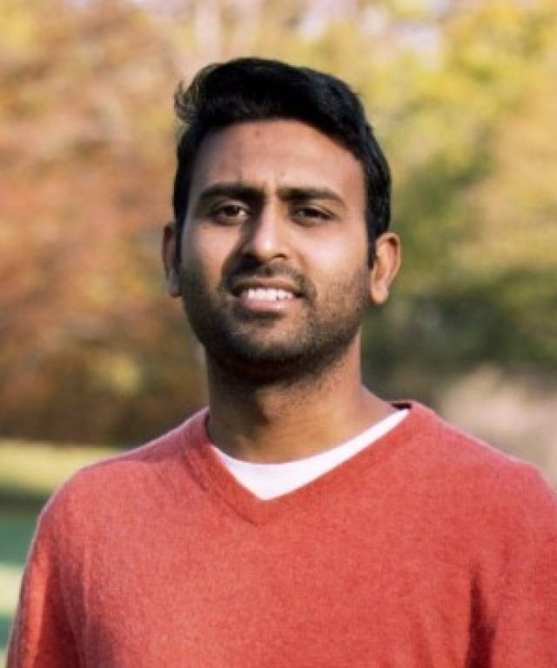
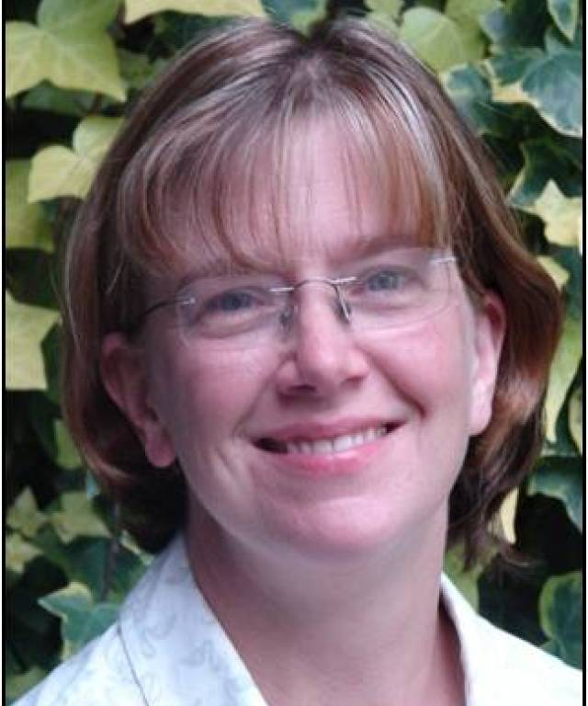
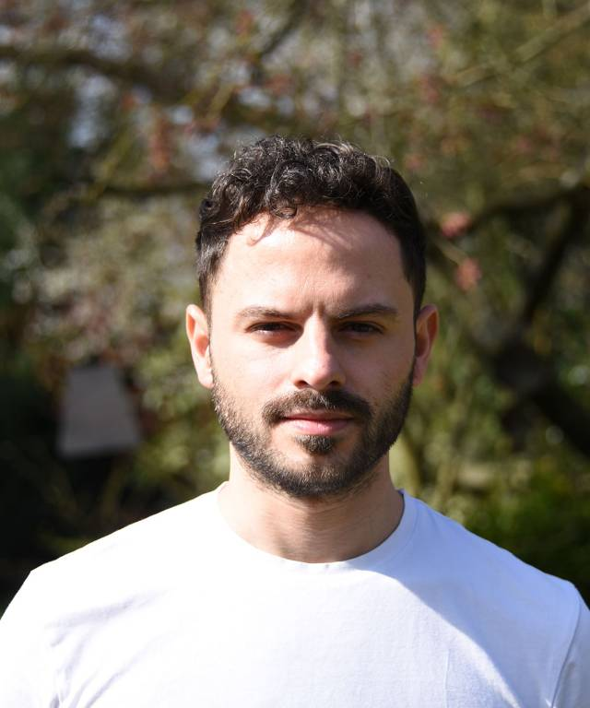
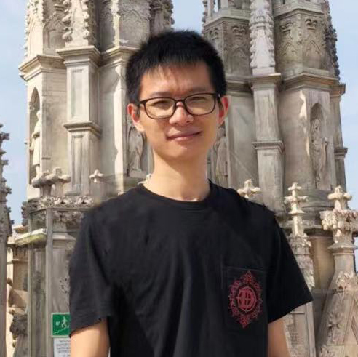
Postdoctoral researchers
Domenic DiFrancesco
(AI Assurance)
Sharana Shivanand
(Bioengineering)
Rebecca Ward
(Digital Twins for Agriculture)
Zack Xuereb
Conti
(Physics-Informed Machine Learning)
Chaoqun Zhuang
(Digital Twins of Energy Systems)

Slide 33
Data-Centric Engineering programme delivery team
Adam Sobey
Programme Director (0.8)
Business
Research
Ed Willis
Personal Assistant (0.33)
Tba
Critical Infrastructure Theme Lead (0.4-0.6)
Domenic DiFrancesco
Turing Research Fellow (1.0)
Florian Ostmann
Head of AI Governance and Regulation (0.1)
Tba
Research Software Engineer (1.0)
Katy Henderson
Programme Manager (1.0)*
Gabin Kayumbi
Senior Research Community Manager (1.0)
Mark Saunders
Partnerships Lead (0.2)^
Tba
Research Application Manager (1.0)
Tba
Digital Manufacturing Theme Lead (0.4-0.6)
Sharana Shivanand
Research Associate (1.0)
Tba
Policy Fellow (1.0)
Alice Budden
Research Project Manager (1.0)
Xander Brouwer
Partnerships Development Manager (0.2)
Tba
Humanities Theme Lead (0.4-0.6)
Rebecca Ward
Turing Research Fellow (1.0)
Tba
Programme Coordinator (1.0)
Tba
Maritime Cybersecurity Theme Lead (0.4-0.6)
Zack Xuereb Conti
Turing Research Fellow (1.0)
Numbers in parentheses = FTE dedicated to DCE programme
Solid line = direct line management
Dashed line = indirect/partial line management
*Currently seconded. Substantive role is occupied by Anastasia Shteyn (0.5), currently on parental leave.
^Mark Saunders is currently on long term sick leave
Chaoqun Zhuang
Research Associate (1.0)

Slide 34

DCE journal
Open access
Cambridge University Press
Academia and industry
Editor-in-Chief Mark Girolami
Research articles, translational papers, systematic reviews, tutorial reviews, position papers, perspectives
Impact factor of 3.6 at first attempt
Notes:
Information on DCE Journal

Slide 35
DCE – Programmes Links
AI Standards HUB
Turing Way
COMMS
TPS
Open Source Infrastructure
Open Research Community Management
DCE
Trustworthy systems
URBAN ANALYTICS
SKILLS
&
TRAINING
REG

Slide 36
How to get in touch….
Programme Director
asobey@turing.ac.uk
Programme Director
ewillis@turing.ac.uk
Personal Assistant
Programme Management
khenderson@turing.ac.uk Programme Manager
abudden@turing.ac.uk Research Project Manager
Tools, Practices and Systems
gkayumbi@turing.ac.uk
Senior Research Community Manager
jding@turing.ac.uk
Research Application Manager
Partnerships Lead
msaunders@turing.ac.uk
Partnerships Development Lead
xbrouwer@turing.ac.uk
Partnerships Development Manager
Notes:
…how could someone get in touch with the programme

Slide 37
Sign up to the newsletter turing.ac.uk/data-centric-engineering

